Slide 1
C# Basics Part2
These slides are designed for Game Design Class
Science and Culture University
By Alireza Seddighi.
Email: alirezaseddighi@live.com

Slide 2
coroutines
For programming a Delayed function
IEnumerator functionName(){ yield return new WaitForSeconds (amount of wait f); print (“print"); }
IEnumerator printsthofterawhile(){ yield return new WaitForSeconds (2f); print ("Wait for 2 Sec"); }
How to call ???

Slide 3
coroutines
2 ways to call coroutines:
First:
StartCoroutine (FunctionName());
StartCoroutine (printsthofterawhile());
Secend:
StartCoroutine (" FunctionName "); StopCoroutine (" FunctionName ");
What’s the Deference???

Slide 4
classes
Classes are blueprint for creating objects
public class Player {
} Constructs: used to initialized the variables
public Player(){ health = 150; power = 100; name = "prince"; Debug.Log ("player instantiate, Health = " + health + " Power = " + power + " Name = " + name); }

Slide 5
objects
Creating an object
From the class = call the constructor
Player prince = new Player ();
Note: we call the constructor

Slide 6
Constructor with argument
public Player (int health, int power, string name){ // this. is referred to the current class this.health = health; this.power = power; this.name = name; Debug.Log ("player instantiate, Health = " + health + " Power = " + power + " Name = " + name); }

Slide 7
Using functions in class
public Player(int health, int power, string name){ // this. is referred to the current class this.health = health; this.power = power; this.name = name; Debug.Log ("player instantiate, Health = " + health + " Power = " + power + " Name = " + name); }
How to call the function:
prince.playerinfo ();

Slide 8
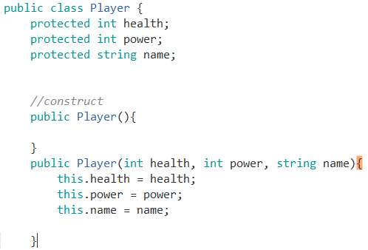
inheritance
Is going to inherit every function variable from the parent class

Slide 9
Inheritance – override function
Override a function in the child class
How to declare such function in parent class?
How to override function in child class?

Slide 10
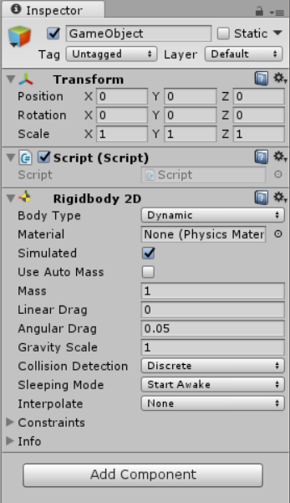
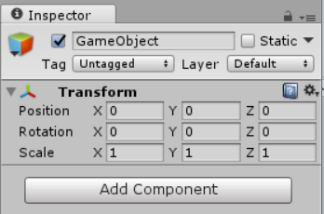
Get component
First Step is to attach the component to the game object
By selecting the game object and Add Component

Slide 11
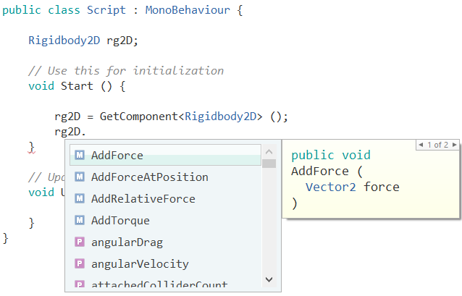
Get component
Second Step is to referenced that component in the script
1. create a variable
2. use the GetComponent to referenced
3. and then use the available functions

Slide 12
encapsulation
Is used for accessing private variable
Need to declare Get and Set function
Get function is to return the predefined value of private variable
And Set function is to Set a proper value to the private variable

Slide 13
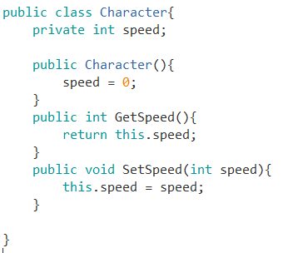
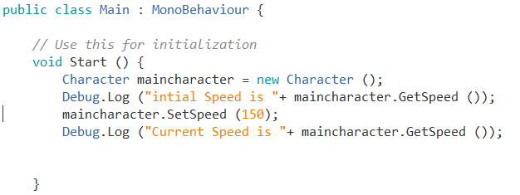
encapsulation

Slide 14
delegates
Static variables
Using the variable that define in a class without creating any object from that class

Slide 15
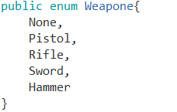
Enumerations
A list of things
How to make Enumeration list ?

Slide 16
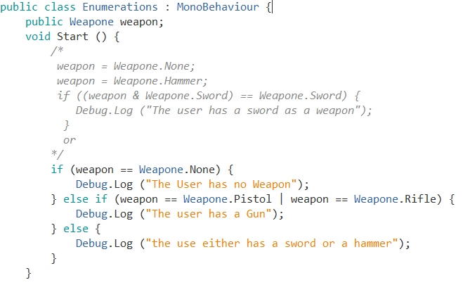
Enumerations
How to use Enumeration list ?

Slide 17
Enumerations
How to use Enumeration list ?

Slide 18
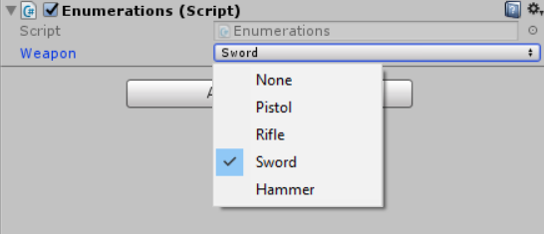
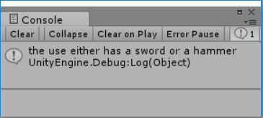
Enumerations

Slide 19
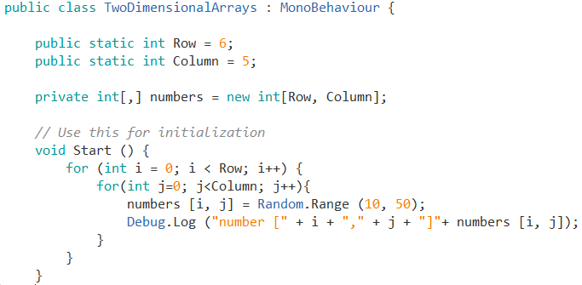
Two Dimensional Arrays

