Slide 1
C# Basics
These slides are designed for Game Design Class
Science and Culture University
By Alireza Seddighi.
Email: alirezaseddighi@live.com

Slide 2
variables
Type Name = value;
Float speed = 5.2f;
Double power = 4.1;
Int points = 0;
Bool isTrueOrFalse = true;

Slide 3
Comments
2 Types of comments:
One line comment
Start with “ // “ and then the comment
Multiple Lines Comment
Start with “/* “
Enter the comment in multiple lines
And End with “ */ “

Slide 4
Print in Console
1. using print function
Print(“the things you want to print in console”);
2. using debug.log
Debug.log(‘the things you want to print in console”):

Slide 5
Assignment and Arithmetic Operators
Assignment Operators
=
+=
-=
*=
/=
%=
Arithmetic Operators
+
-
/
*
%

Slide 6
Comparison and Logical Operators
Comparison Operators
== Equal to
!= Not Equal to
> Greater than
< Less than
>=
<=
Logical Operators
&& And
|| or
! Not

Slide 7
Function
Create the function :
Accessors Type name ()
{
The Functionalities
}
Calling the Function:
FunctionName();
For example in Start function() or in Update Function()
Note:
there is other prebuild Functions void Awake (){}. What’s the use of this Function?

Slide 8
4 type of functions
Type 1:
Takes no argument and does not return any values
Type 2:
Takes arguments and does not return any values
Type 3:
Takes no argument and returns values
Type 4:
Takes arguments and returns values

Slide 9
4 type of functions
Type 1:
Takes no argument and does not return any values
Void print(){
Debug.log(“print”);
}

Slide 10
4 type of functions
Type 2:
Takes arguments and does not return any values
Void printArgument(string message){
Debug.log(message);
}
How to call:
printArgument(“String”) ;

Slide 11
4 type of functions
Type 3:
Takes no argument and returns values
Int returnTheValue(){
Retun 2;
}

Slide 12
4 type of functions
Type 4:
Takes arguments and returns values
Int returnTheSum(int a, int b){
Int c = a + b;
Retun c;
}
How to call:
returnTheSum(number 1 , number 2);

Slide 13
Code Flow
Controlling Code Flow

Slide 14
Code Flow
First rule
Start from Top to bottom
And it goas Left to right

Slide 15
If Statements
Statements that run code based on a scenario being true or false, generally written if x then y, else z
else if
Else
If (this condition x is met){
do this
}else if (this condition y is met){
do this
}else {
Neither of the conditions are met then do this
}
Note: it is a good practice to use if and else if statement only if you have less than 5 conditions
What’s the alternative then ?

Slide 16
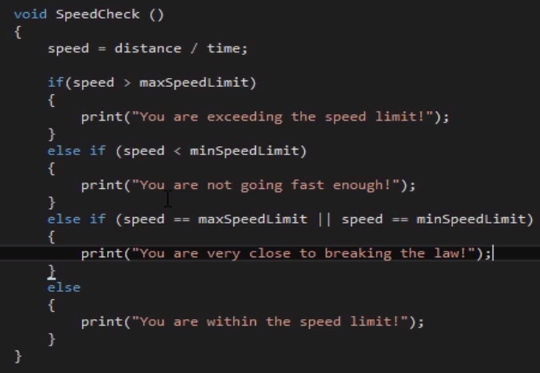
If, else if, else

Slide 17
Switch/case Statements
Usually used when to much condition must be checked.
Switch /Case
Switch (Some variable like Weapon)
{
Case 1:
Debug.log(“knife”);
Break;
Case 2:
Debug.log(“axe”);
Break;
Case 3:
Debug.log(“dagger”);
Break;
Case 4:
Debug.log(“bow”);
Break;
Default:
Break;
}

Slide 18
Write a code with if/else and switch/case
Randomly generate a number between 1 t0 5
Assign each number between 1 to 5 to a weapon
Check the weapons with if/else if /else and switch/case

Slide 19
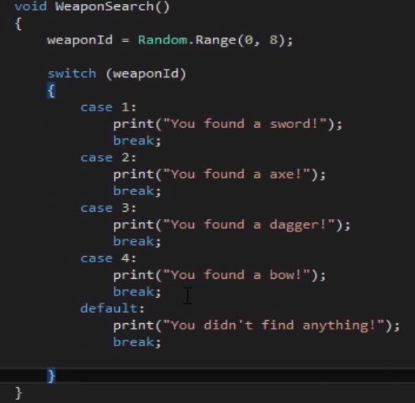
Switch Statement

Slide 20
Loops
Multiple repetitions of the same task
Type of loops
For
While
Do while
Foe each

Slide 21
For loop
If(lower bound ; upper bound ; number of hops for increase of decrease) {
Debug.log(“something”);
}
If (i=0; i< 10 ; i++){
print(i);
}

Slide 22
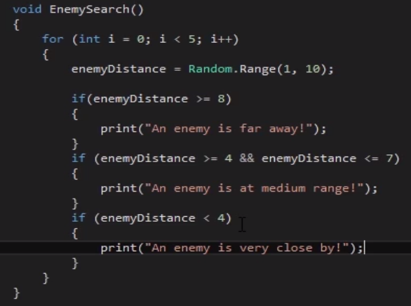
For loop

Slide 23
While loop
While (the condition is true ){
Print (“”);
}
int a = 0
While (a < 10){
Print (a);
a++;
}
Note: infinite loop problem

Slide 24
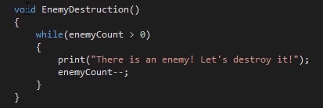
While loop

Slide 25
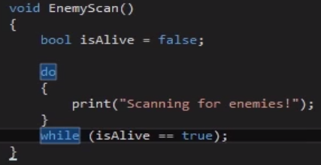
Do while loop

Slide 26
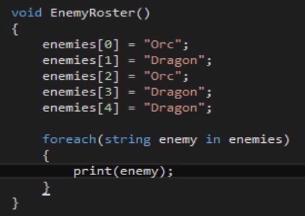
For each loop

Slide 27
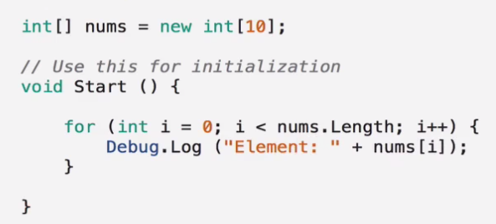
arrays
Create multiple variables of the same type
Is a fix sized data structure
Type[] name = new type [size];
Note:index out of Bound

